Slide 1
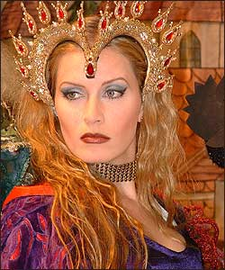
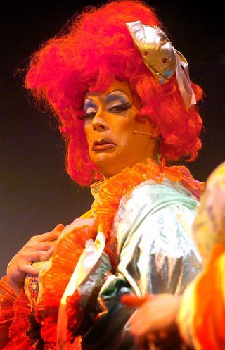
PANTOMIME
Yr 7 Drama
Lesson 6
Assessment

Slide 2
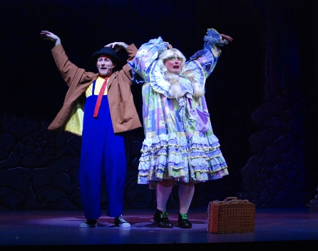
RANDOM REGISTER
In true Pantomime style let’s answer the register with an unusually large and exaggerated performance.
When I say is ……..here?
You must say “Oh Yes he is” or “Oh No she isn’t”

Slide 3
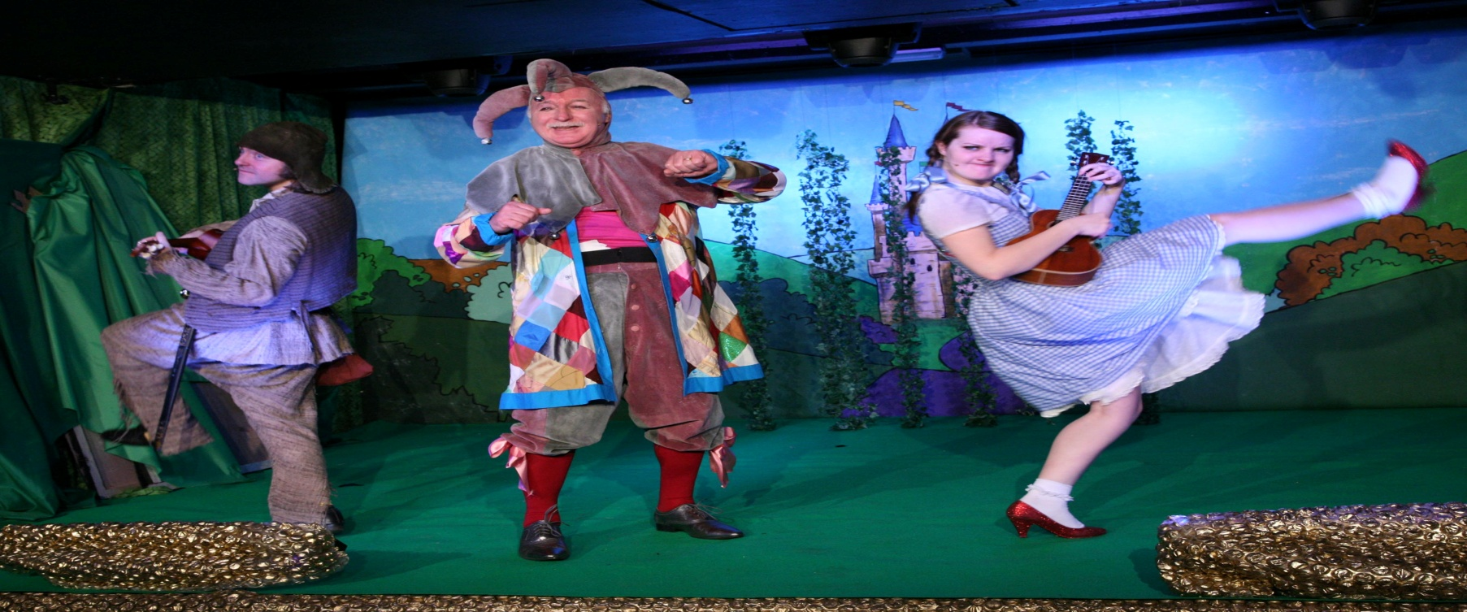
LESSON OBJECTIVE
To assess the scene performances.

Slide 4
Level | Drama Strand
 | Creating | Performing | Reflecting
Entry | I can take part in a drama activity | I can participate in part of a group performance | I can identify positive and negative aspects within my work
1 | I can take part in a range of drama activities I can explore problems in an imagined world and make up plays from stories or other stimuli | I can participate in a short group performance I show some consideration of movement and voice in performance | I can make simple connections between the dramas I experience and my own life I can recognise when my own work and the work of others’, could be improved
2 | I can perform my own simple scenes, demonstrating an understanding of drama techniques | I can use my voice and body to create a simple character I can act out improvised dramas | I can talk about why I made certain decisions in my play I can show a basic understanding of how meaning can be shown
3 | I can establish a character with control over movement and voice I can use the dialogue in existing texts as well as creating my own I can devise plays from a range of stimuli I can respond to the use of drama techniques to deepen the role or understanding of the situation e.g. hot seating I can sustain a defined character for a reasonable amount of time | I can learn lines and organise simple performances | I can give suggestions on how work could be improved I can talk about my work using some technical drama terminology I can discuss and give reasons for my preferences in the drama I have seen

Slide 5
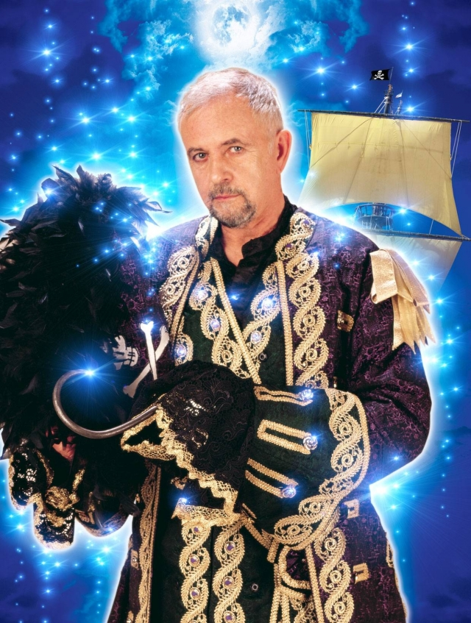
THE TASK
Lesson Objective:
To assess the scene performances..
To understand how to perform in a pantomime.
You perform a panto scene.
THE CHOICES…
A routine or gag
Students own scene with a routine or gag.
Perform the ‘GHOST GAG’

Slide 6
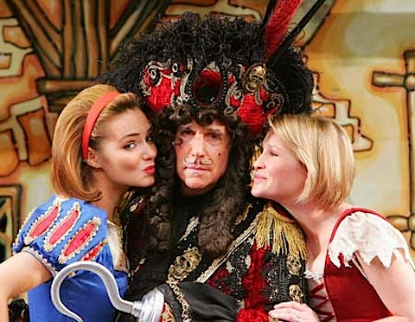
Last Practice/Rehearsal
Lesson Objective:
To assess the scene performances..
To understand how to perform in a pantomime.
Last chance to practice…
Remember PRACTICE MAKES PERFECT
Work hard and prepare to be filmed for your assessment.
YOU HAVE 5 MINS

Slide 7
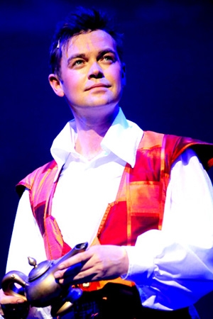
Assessment Filming
Lesson Objective:
To assess the scene performances..
To understand how to perform in a pantomime.
Let’s finish assessing some students work.
REMEMBER…
What Went Well
Even Better If?

Slide 8
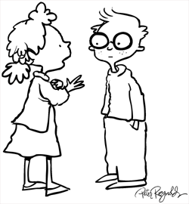

Lesson Objective:
To assess the scene performances..
To understand how to perform in a pantomime.
RallyRobin
Using the topic given, the partner that _____________ goes 1st.
After the 1st partner shares one thing, partner 2 shares one thing; repeat.
You “Rally” the topic like this until the teacher calls time.

Slide 9
THE TOPIC
Lesson Objective:
To assess the scene performances..
To understand how to perform in a pantomime.
QUESTION
HINTS
List as many things as you can remember in the pantomime scheme of work.
Think about…
Stock Characters
Gags & Routines
Audience Participation
Ghost Gag
Skills you have used throughout

Slide 10
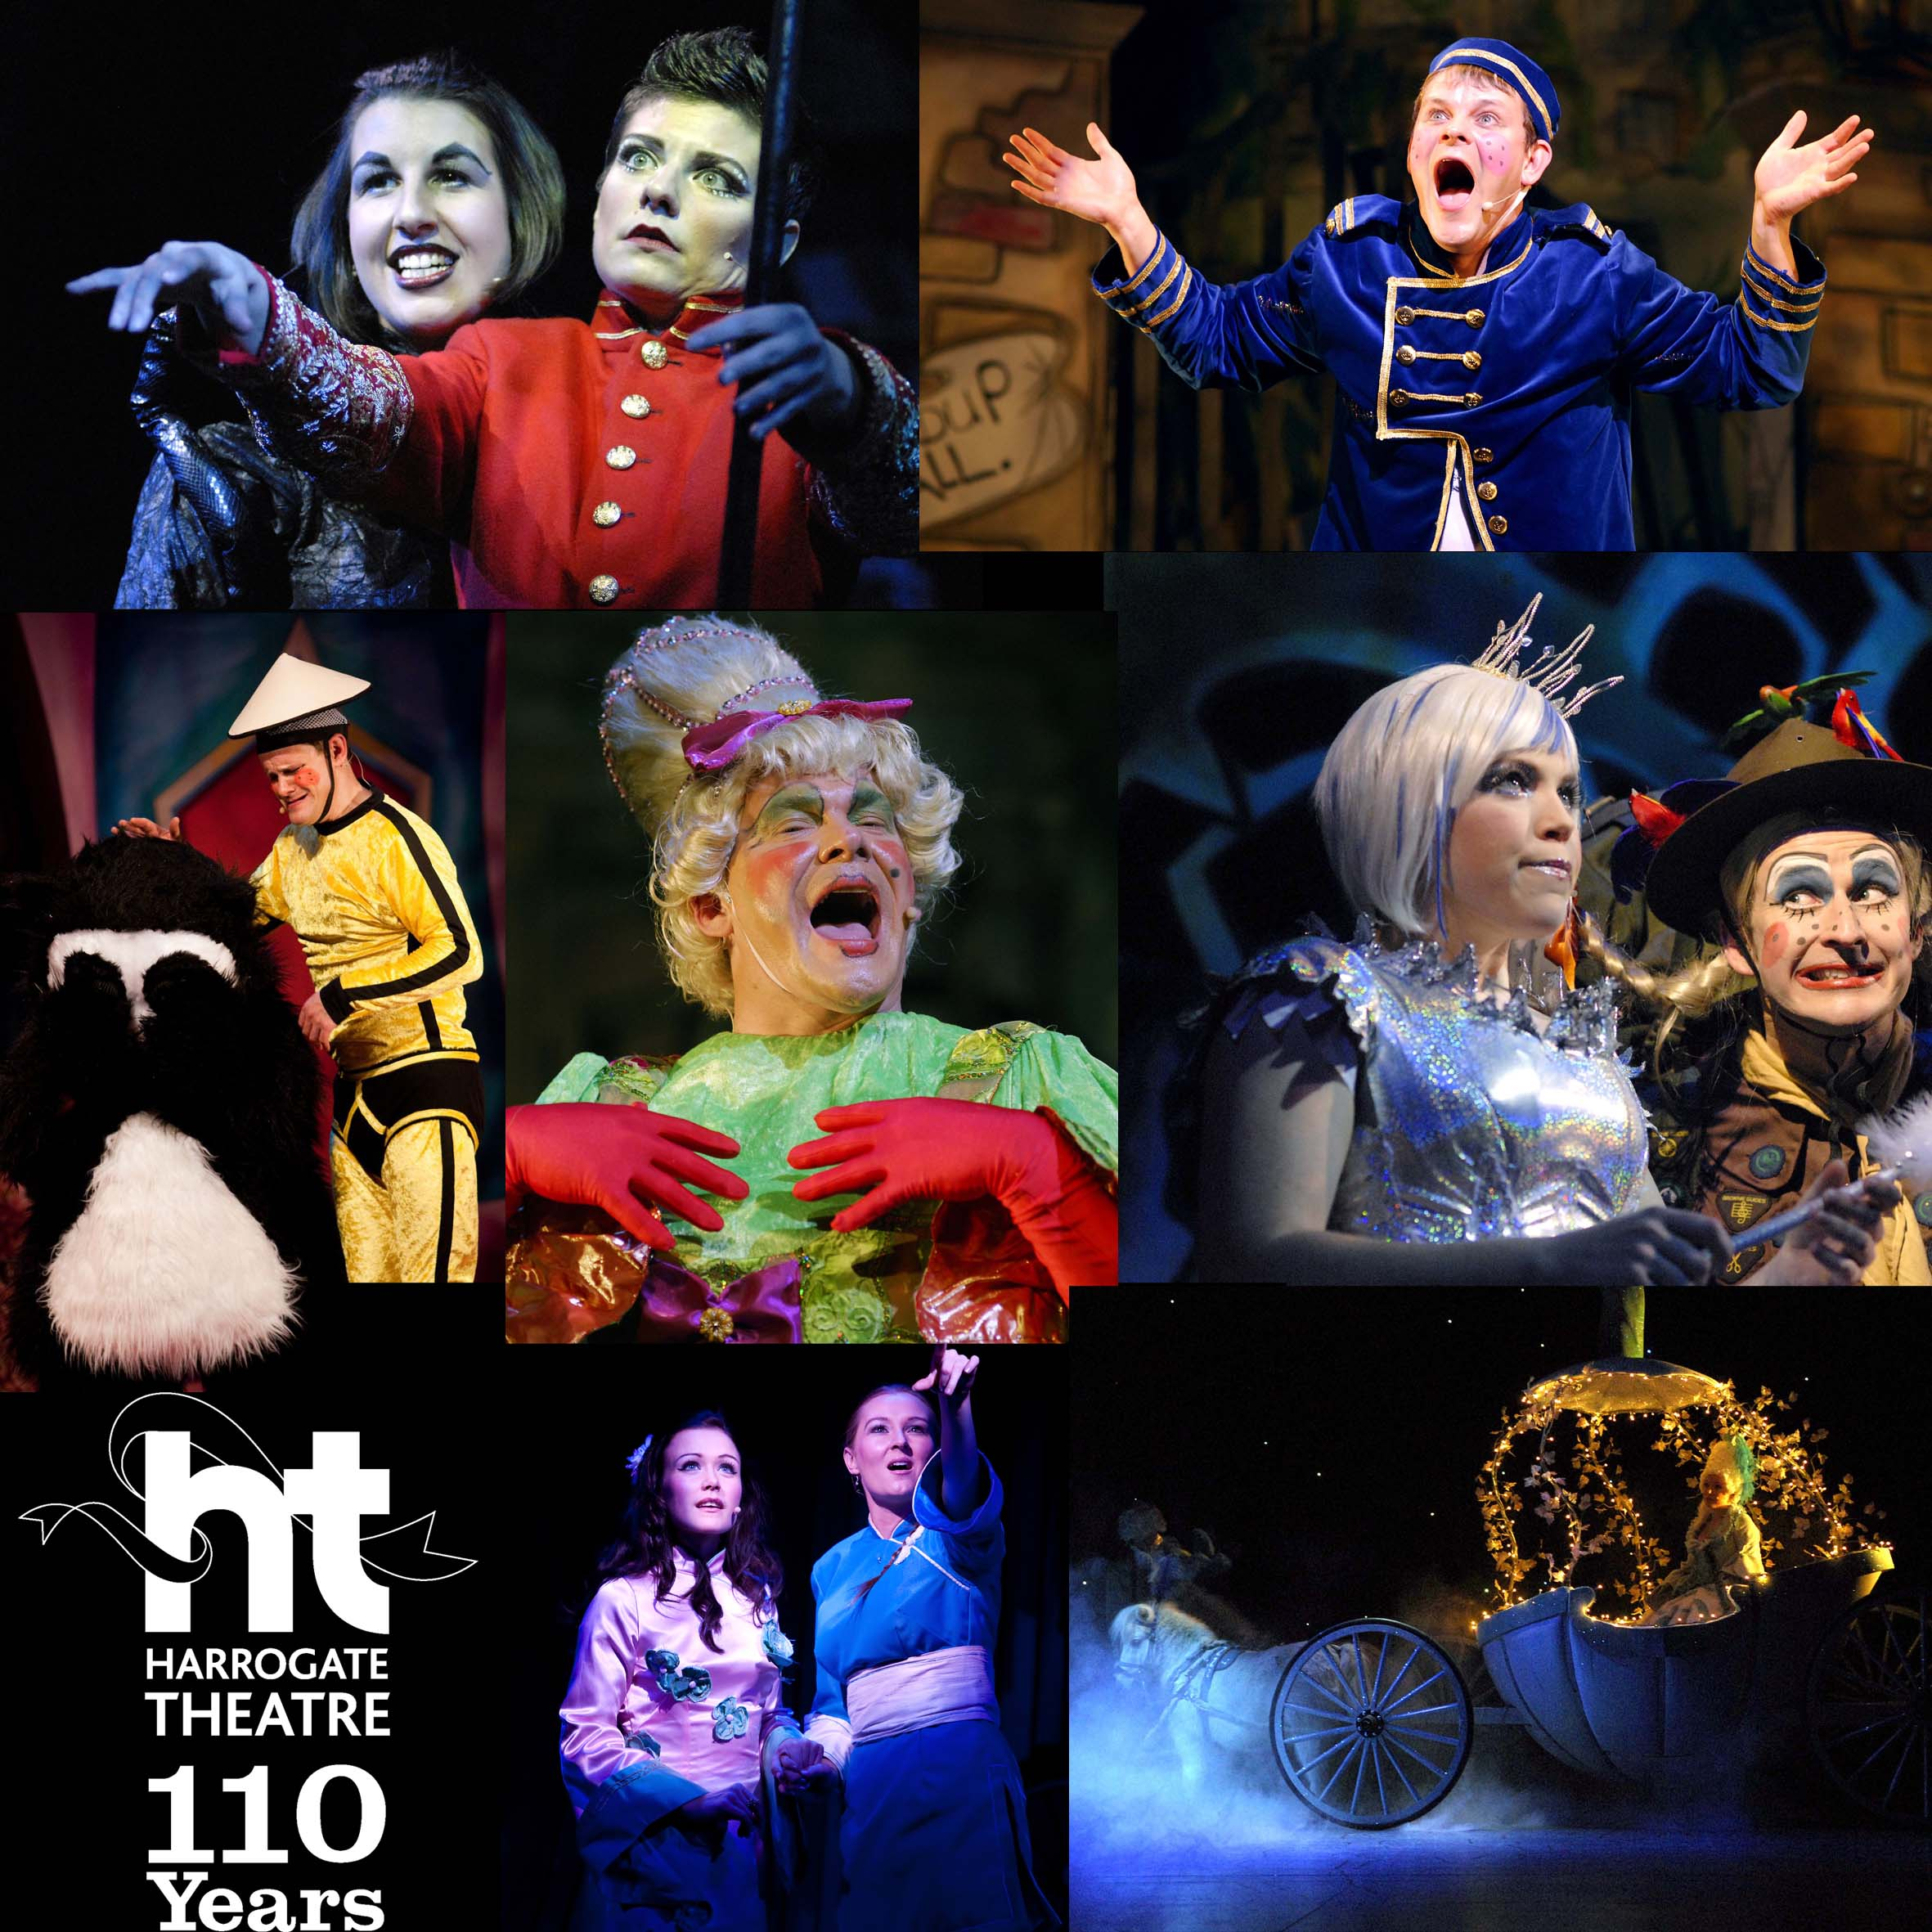
EVALUATION
Fill out the evaluation document on your own and in silence! Try to remember everything we have done.

